Slide 1




E COMMERCE DATA ANALYSIS USING EXCEL
STUDENT NAME: ABINESH.V
REGISTER NO:422200002
DEPARTMENT:B.COM (ISM)
COLLEGE:S.I.V.E.T COLLEGE

Slide 2

E-COMMERCE DATA ANALYSIS USING EXCEL

Slide 3


AGENDA
Problem Statement
Project Overview
End Users
Our Solution and Proposition
Dataset Description
Modelling Approach
Results and Discussion
Conclusion
3/21/2024 Annual Review

Slide 4

Problem statement in e commerce A problem statement for e-commerce can help you focus on the challenges your business faces and how to address them. Here are some common problems that ecommerce businesses face

Slide 5
E- commerce is the buying and selling of goods and services over the internet. It is conducted over computers, tablets, smartphone, and other smart devices. Almost anything can be purchased through e-commerce today, which makes makes e-commerce commerce highly competitive.
Project overview in e commerce

Slide 6
A value proposition for your e-commerce store is a statement that differentiates you from the crowd and explains to your customers why they should buy your product.
OUR SOLUTION AND ITS PROPOSITION

Slide 7
Helps companies monitor consumer demand, analyze shopper behavior, and optimize search strategies to win in the Ecommerce world.
DATASET DESCRIPTION

Slide 8

There are multiple matches for “the wow in our solution in e-commerce”, including a service provider and ways to create a wow factor for customers. An e-commerce service provider that helps businesses create attractive and easy-to-use websites.
THE “WOW”IN OUR SOLUTION

Slide 9

WHO ARE THE END USERS
Businesses: Companies purchasing supplies, equipment, or services.
Individual Consumers: Shoppers buying products for personal use, such as clothing, electronics, or groceries.
Organizations: Nonprofits or governmental entities that buy goods or services for operational needs.
Mobile Users: Consumers using smartphones or tablets to shop online, which has been a growing segment.
International Shoppers: Customers from various countries buying from e-commerce sites across borders.
Each group has unique needs and preferences, influencing how e-commerce platforms are designed and marketed.

Slide 10
MODELLING
E-commerce modeling involves defining the structure, processes, and strategies that govern an online business. Here are some key models in e-commerce:
. Business Models
Revenue Models
Marketing Models
Supply Chain Models
Customer Engagement Models

Slide 11
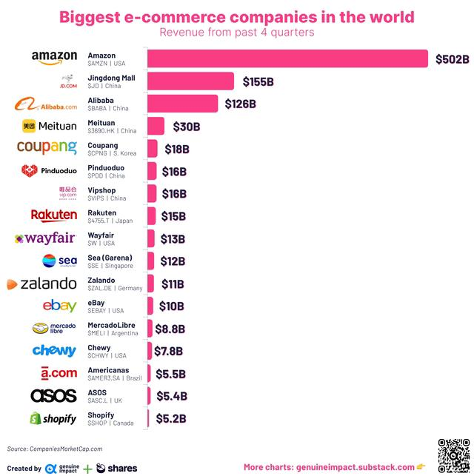
RESULT IN E- COMMERCE

Slide 12
CONCLUSION
In conclusion, e-commerce has transformed the way businesses operate and consumers shop, offering unparalleled convenience and accessibility. Its diverse models—ranging from B2C to C2B—cater to various market needs, allowing businesses to innovate and adapt in a rapidly changing digital landscape.

